Slide 1
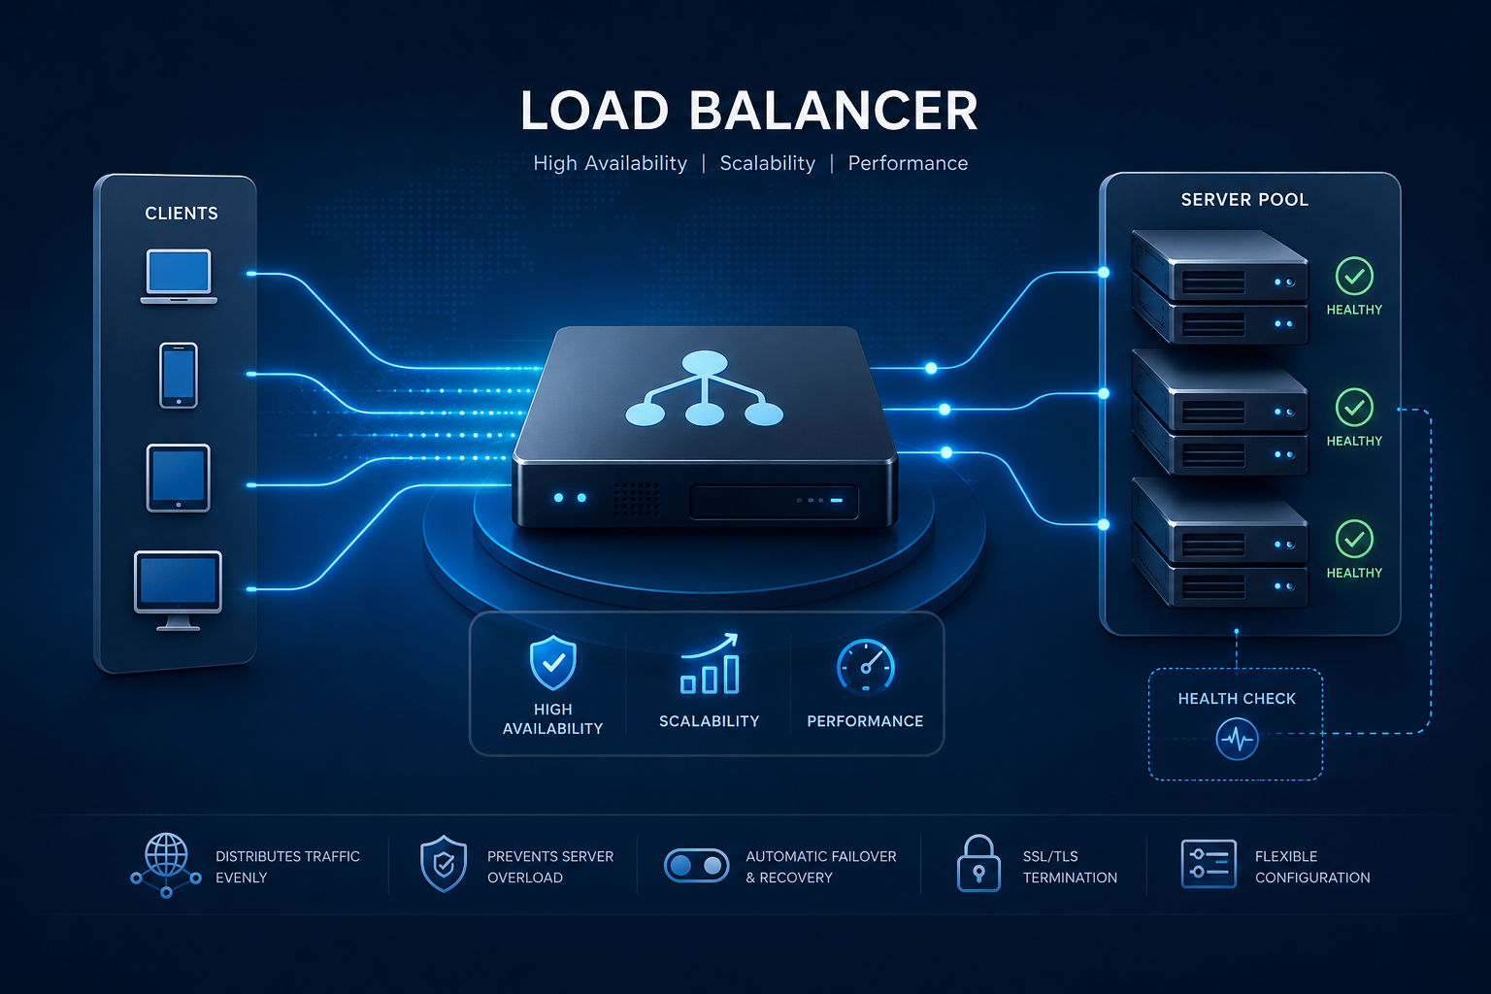

Slide 2
📌INTRODUCTION
A Load Balancer is a service that distributes incoming network traffic across multiple servers (such as EC2 instances) to ensure high availability, reliability, and optimal performance. It prevents any single server from becoming overloaded, improves application response time, and automatically routes traffic only to healthy servers. In cloud environments like Amazon Web Services (AWS), load balancers help build scalable, fault-tolerant, and highly available applications.
🗒️PREREQUISITES
Before you begin, ensure you have:
An AWS account
Basics Knowledge of AWS EC2 Security Groups, Target Groups and Load Balancing
Internet Access to log into AWS Management Console
ELB PROJECT DOCUMENTATION BY MOHIT GADILOHAR

Slide 3
1. Security Group
"First, I created a Security Group. A Security Group acts as a virtual firewall that controls inbound and outbound traffic. I allowed HTTP (80) and HTTPS (443) traffic for users, and SSH (22) for secure administration."
Role: Protects the Load Balancer and EC2 instances by allowing only required traffic.
2. EC2 Instance
"Next, I launched EC2 instances. An EC2 instance is a virtual server in AWS where I deployed my web application. These instances process user requests."
Role: Hosts and runs the application.
3. Target Group
"After that, I created a Target Group and registered my EC2 instances. The Target Group performs health checks and ensures that the Load Balancer sends traffic only to healthy EC2 instances."
Role: Groups EC2 instances and monitors their health.
4. Load Balancer (ALB)
"Finally, I created an Application Load Balancer (ALB). I attached the Security Group, selected the VPC and subnets, and connected it to the Target Group. The Load Balancer receives incoming user requests and distributes them across the healthy EC2 instances."
Role: Distributes incoming traffic to healthy EC2 instances, ensuring high availability, scalability, and fault tolerance.

Slide 4
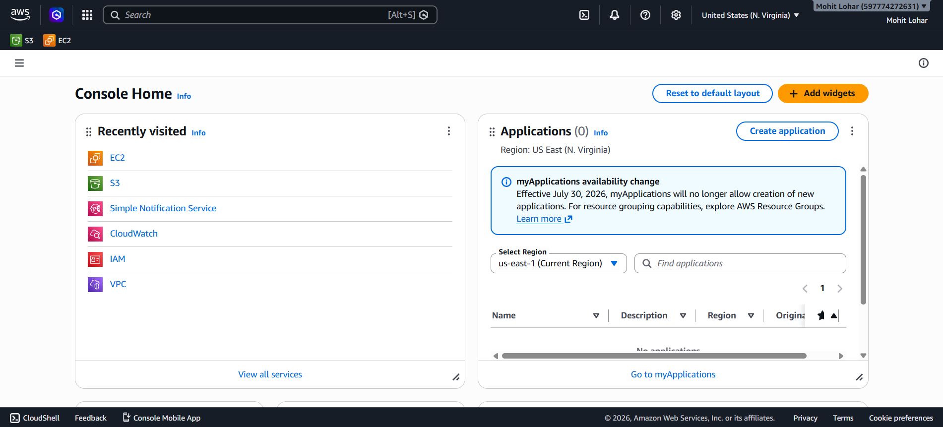
🏗️Steps to Set Up the Infrastructure
CONFIGURE SECURITY GROUP
1. Go to AWS Management Console.
ELB PROJECT DOCUMENTATION BY MOHIT GADILOHAR

Slide 5
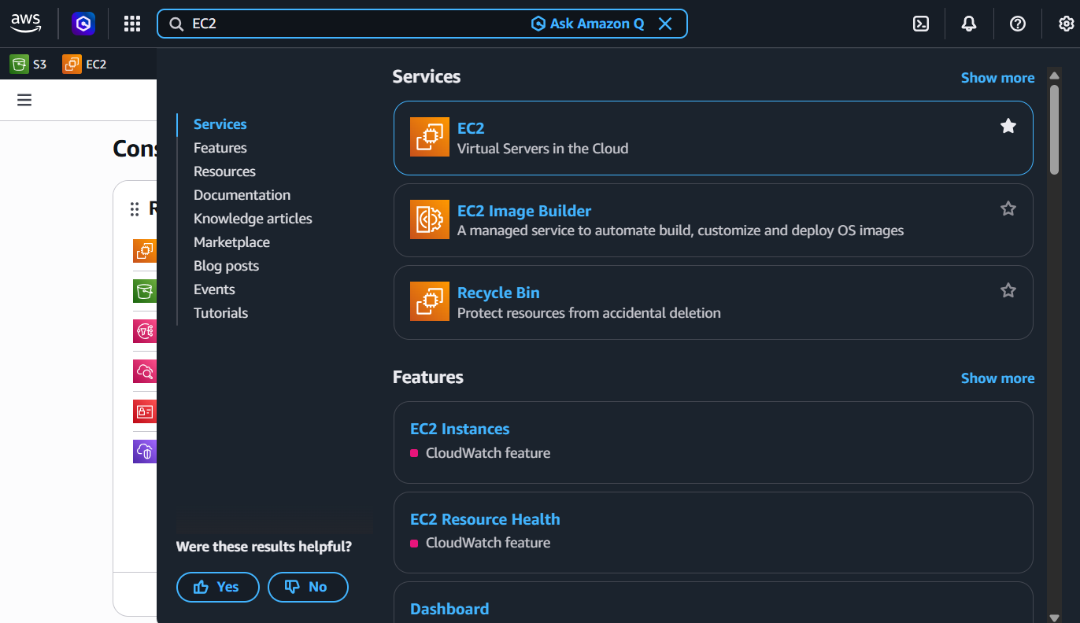
2. Search And Click EC2
ELB PROJECT DOCUMENTATION BY MOHIT GADILOHAR

Slide 6
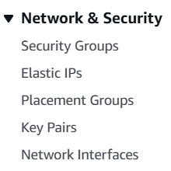
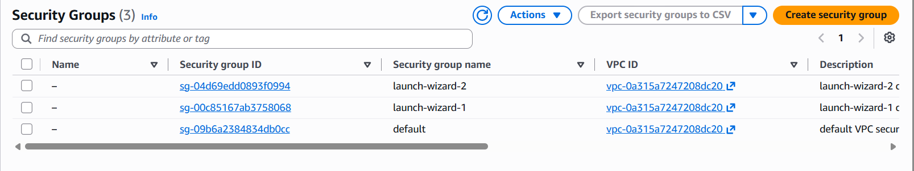
3. Click on Security Group
4. Click on Create Security Group.
ELB PROJECT DOCUMENTATION BY MOHIT GADILOHAR

Slide 7
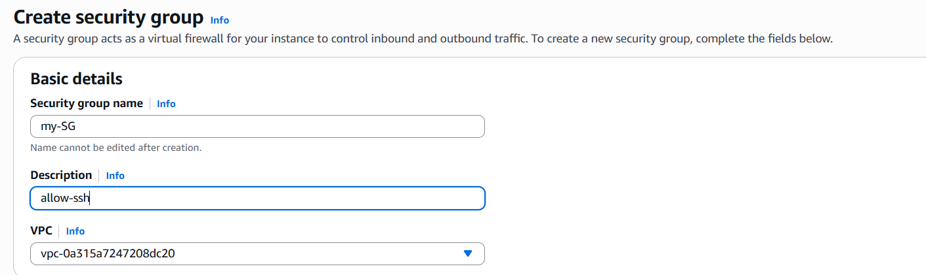
5. Enter Basic Details like Name and description.
ELB PROJECT DOCUMENTATION BY MOHIT GADILOHAR

Slide 8
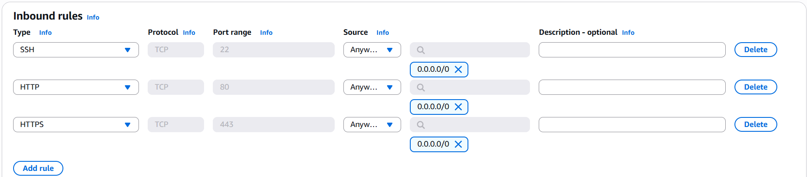
6. In Inbound Rules , add the following rules:
SSH (Port 22)
HTTP (Port 80)
HTTPS (Port 443)
Select Anywhere IPv4 as the source.
ELB PROJECT DOCUMENTATION BY MOHIT GADILOHAR

Slide 9
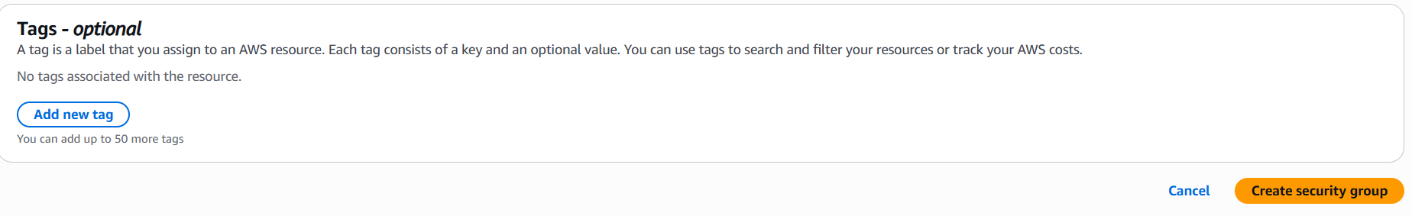
7. Scroll Down and click on Create Security Group
ELB PROJECT DOCUMENTATION BY MOHIT GADILOHAR

Slide 10
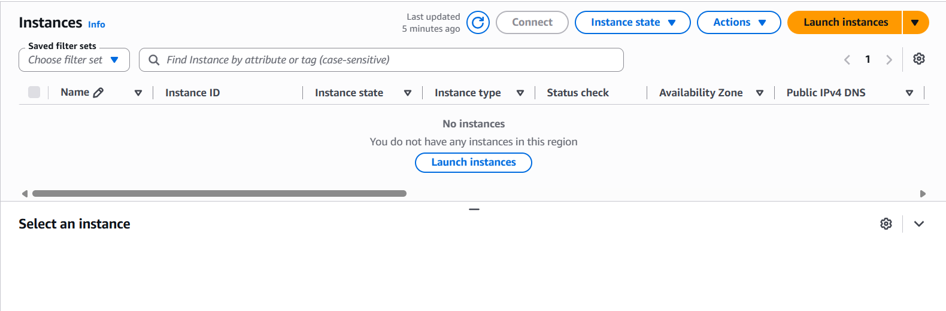
Launch EC2 Instances💻
8. Go to the EC2 Instances Dashboard
ELB PROJECT DOCUMENTATION BY MOHIT GADILOHAR

Slide 11

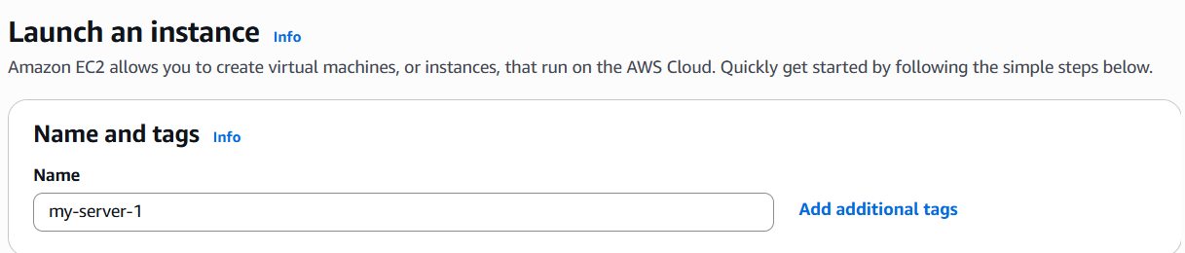
9. Click on Launch Instance
10. Provide a name, Select AMI as Amazon Linux, and choose t2.micro or t3.micro (whichever is free-tier eligible).
ELB PROJECT DOCUMENTATION BY MOHIT GADILOHAR

Slide 12
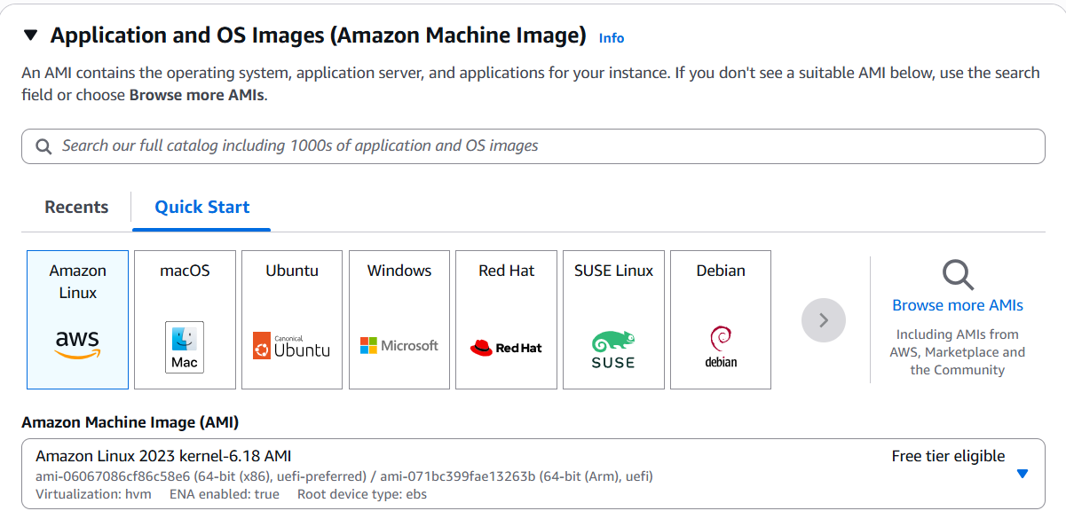
ELB PROJECT DOCUMENTATION BY MOHIT GADILOHAR

Slide 13
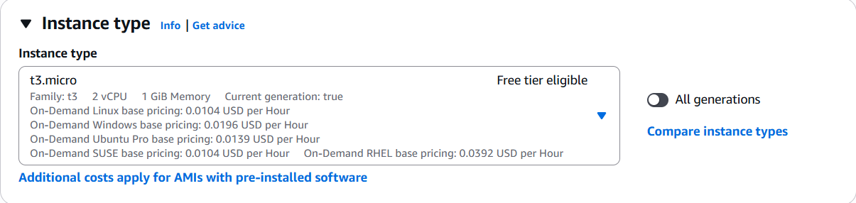
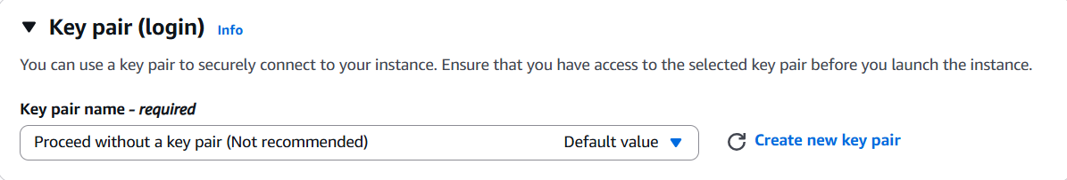
11. Proceed Without a key pair:
ELB PROJECT DOCUMENTATION BY MOHIT GADILOHAR

Slide 14
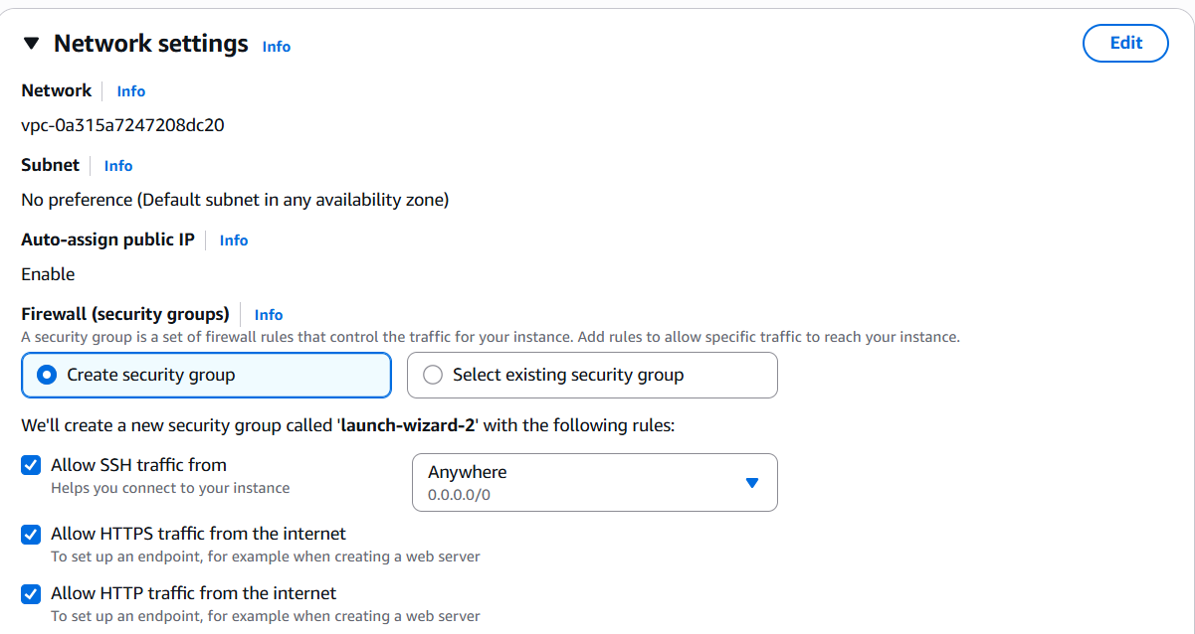
12. In Networking Setting , Select the Create security group create a earlier.
ELB PROJECT DOCUMENTATION BY MOHIT GADILOHAR

Slide 15
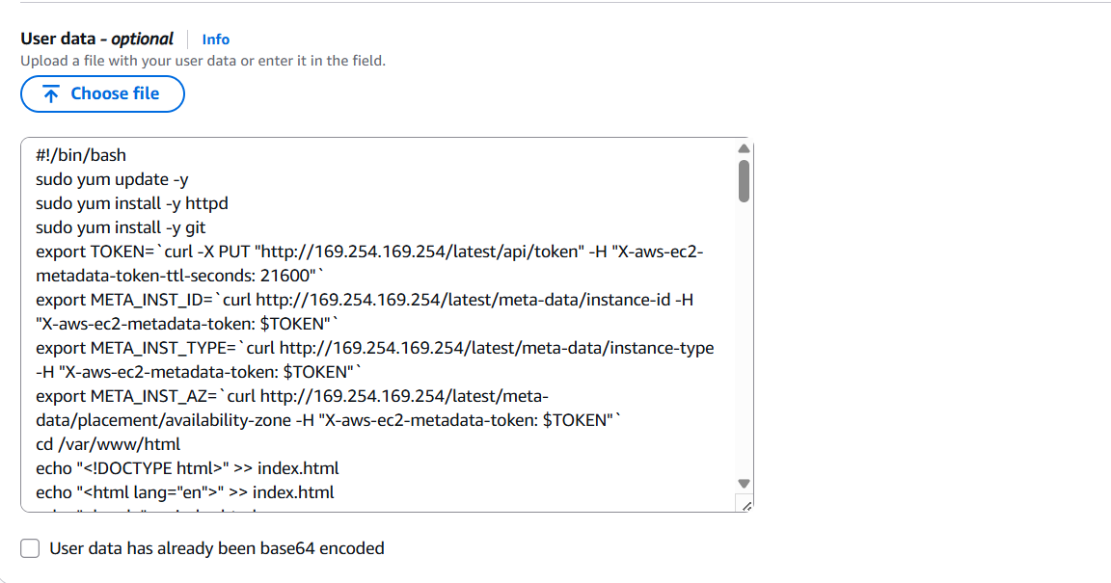
13. Scroll down to Advanced Details and add user Data.
ELB PROJECT DOCUMENTATION BY MOHIT GADILOHAR

Slide 16
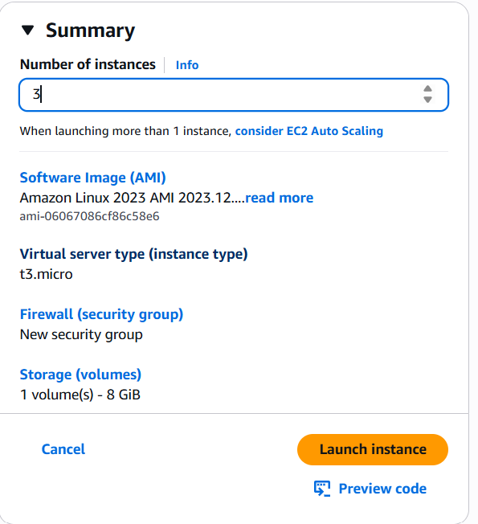
14. Change the number of instances from 1 to 3 in the summary section.
ELB PROJECT DOCUMENTATION BY MOHIT GADILOHAR

Slide 17

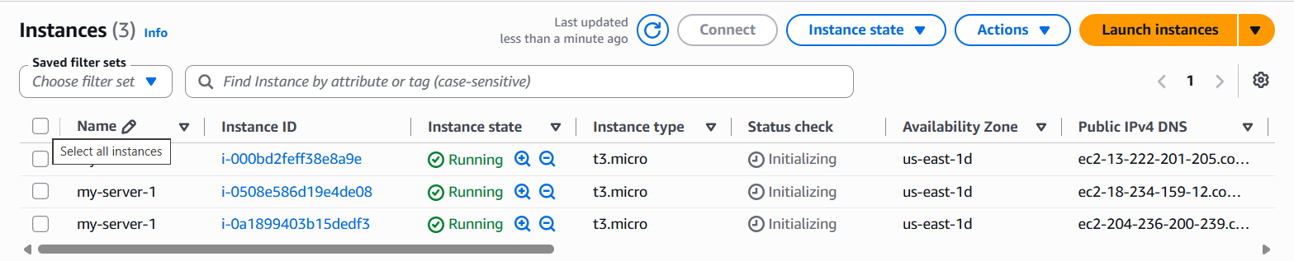
15. Click Launch Instance
16. Navigate to the EC2 Instances Dashboard, wait for the 3/3 instance check to pass.
ELB PROJECT DOCUMENTATION BY MOHIT GADILOHAR

Slide 18
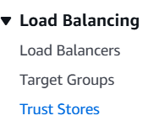
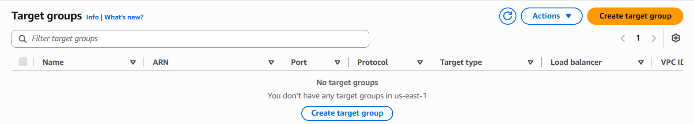
Create the TARGET GROUPS 🎯
17. In the Load Balancing Section, click on Target Groups.
18. Click Create Target Group.
ELB PROJECT DOCUMENTATION BY MOHIT GADILOHAR

Slide 19
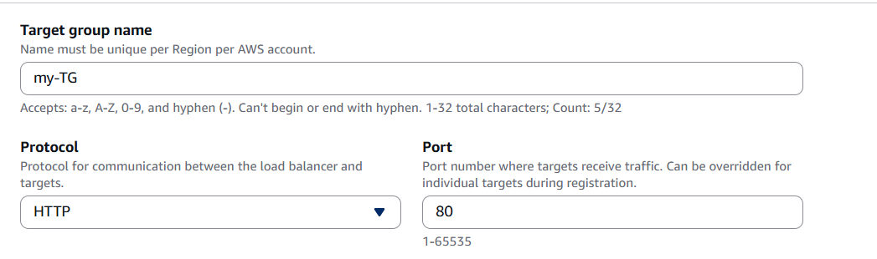
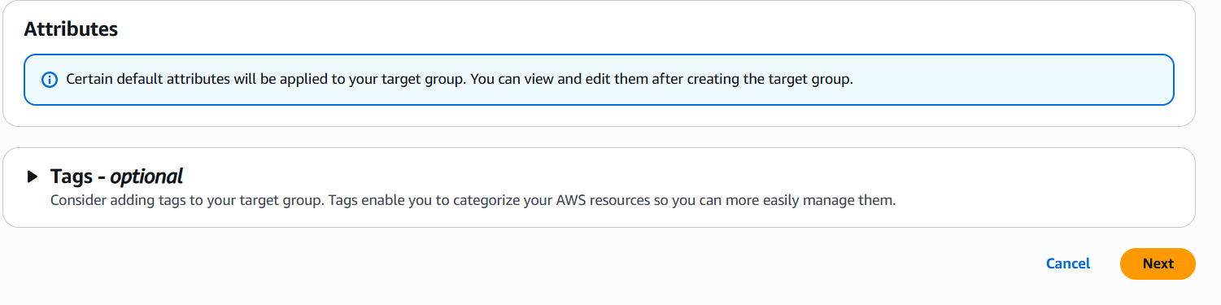
19. Enter a Target Group name, then click Next.
ELB PROJECT DOCUMENTATION BY MOHIT GADILOHAR

Slide 20
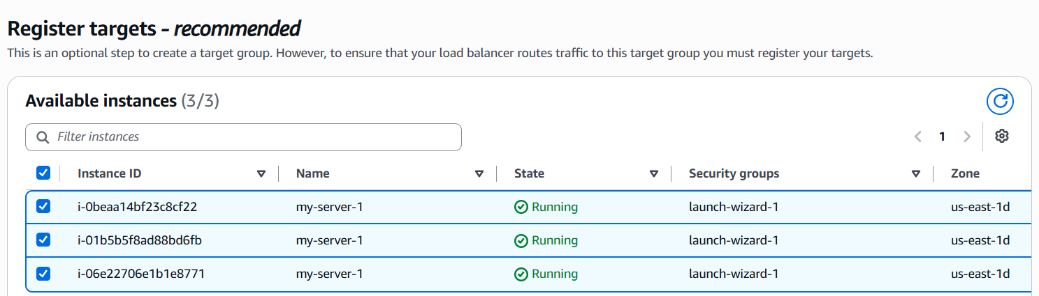
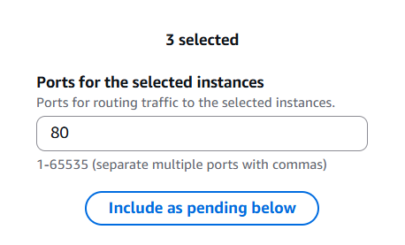
20. Select available instances and Register them.
ELB PROJECT DOCUMENTATION BY MOHIT GADILOHAR

Slide 21
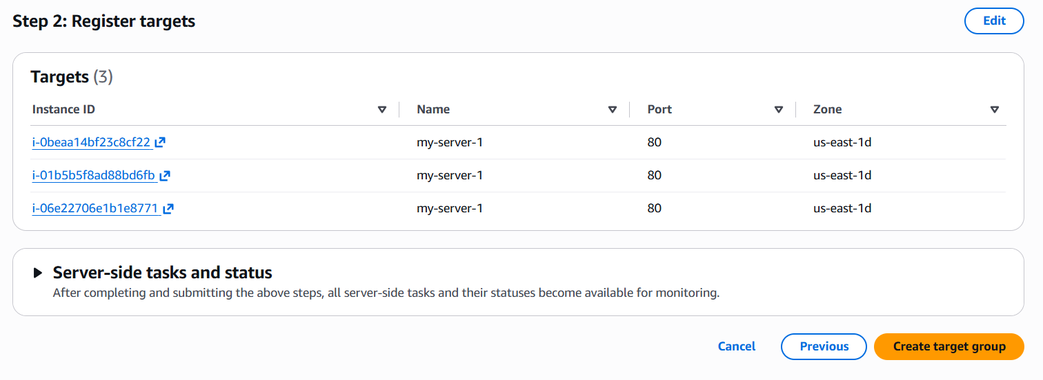
21. Review Target and click Create Target Group.
ELB PROJECT DOCUMENTATION BY MOHIT GADILOHAR

Slide 22
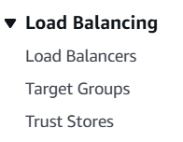
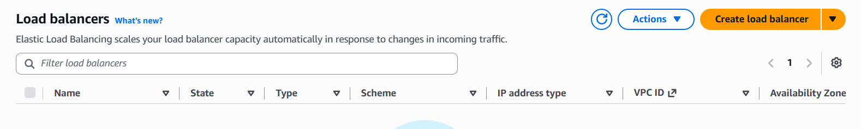
SET UP ELASTIC LOAD BALANCER (ELB)🔄️
22. Go to Load Balancers in the Load Balancing sections
23. Click Create Load Balancer.
ELB PROJECT DOCUMENTATION BY MOHIT GADILOHAR

Slide 23
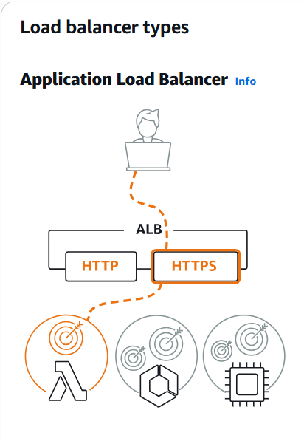
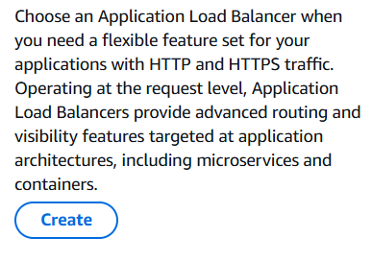
24. Choose the Application Load Balancer (ALB) and click Create
ELB PROJECT DOCUMENTATION BY MOHIT GADILOHAR

Slide 24
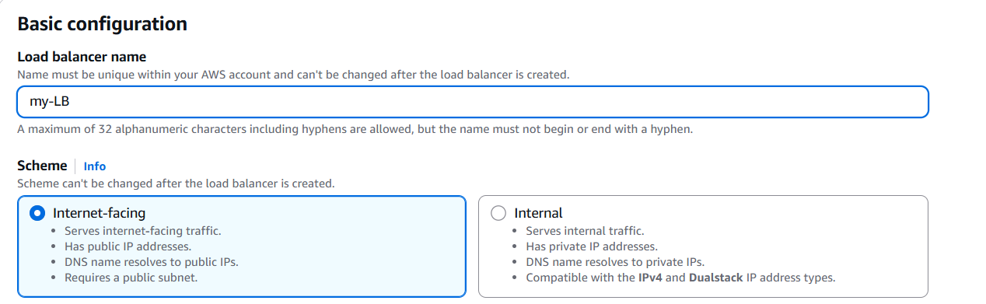
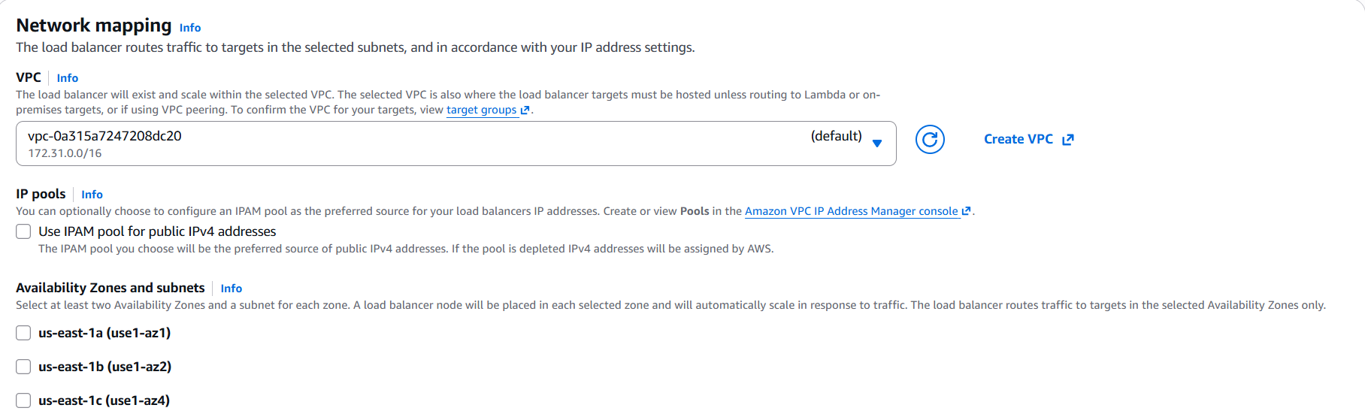
25. Enter the name for the Load Balancer.
26. In Network Mapping choose the Availability zone.
ELB PROJECT DOCUMENTATION BY MOHIT GADILOHAR

Slide 25
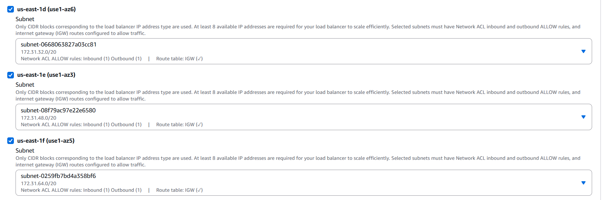
Availability zone
ELB PROJECT DOCUMENTATION BY MOHIT GADILOHAR

Slide 26
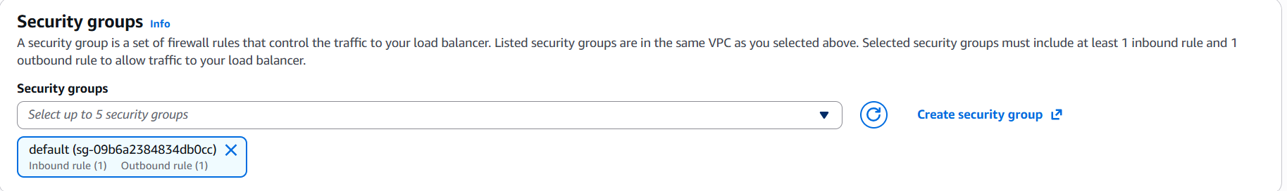
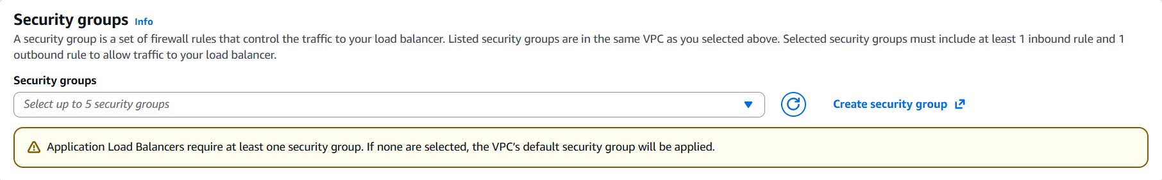
27. In Security Group remove the default Security Group and attach the Security Group created earlier
ELB PROJECT DOCUMENTATION BY MOHIT GADILOHAR

Slide 27
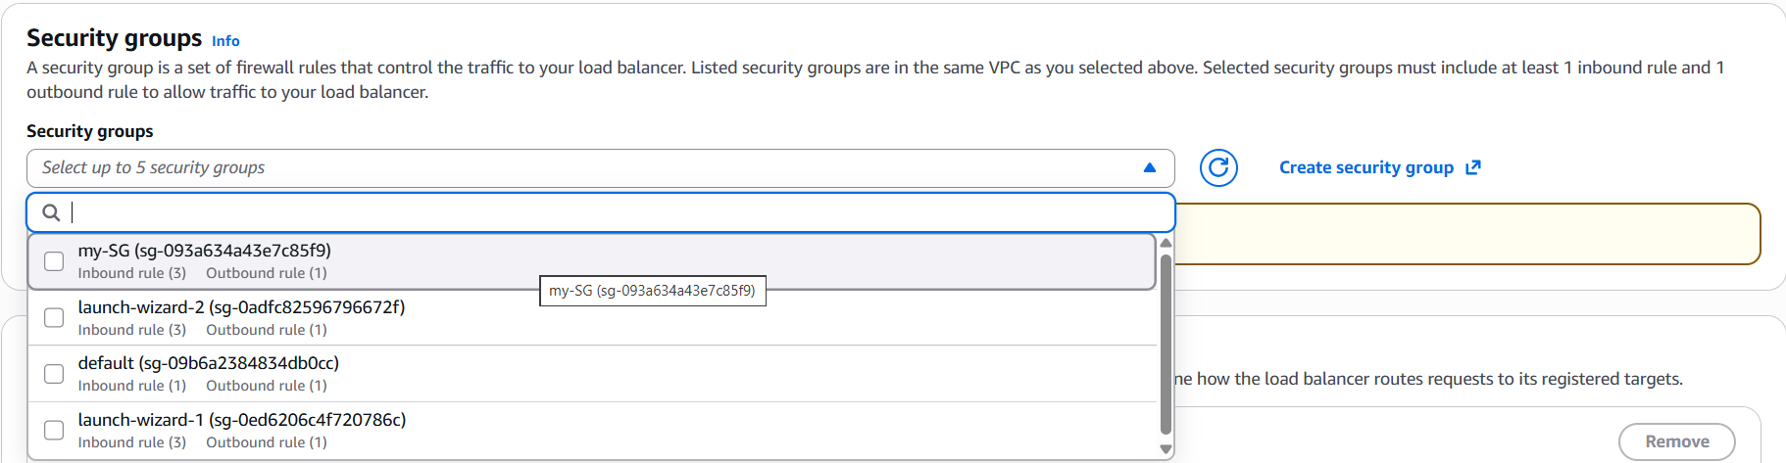
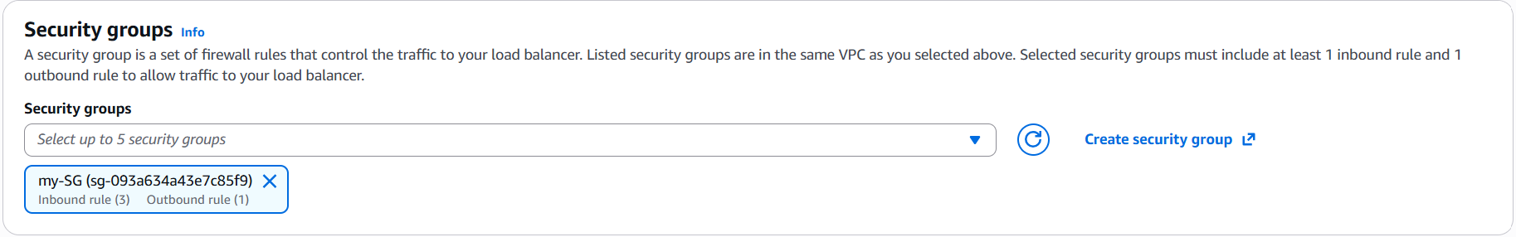
ELB PROJECT DOCUMENTATION BY MOHIT GADILOHAR

Slide 28
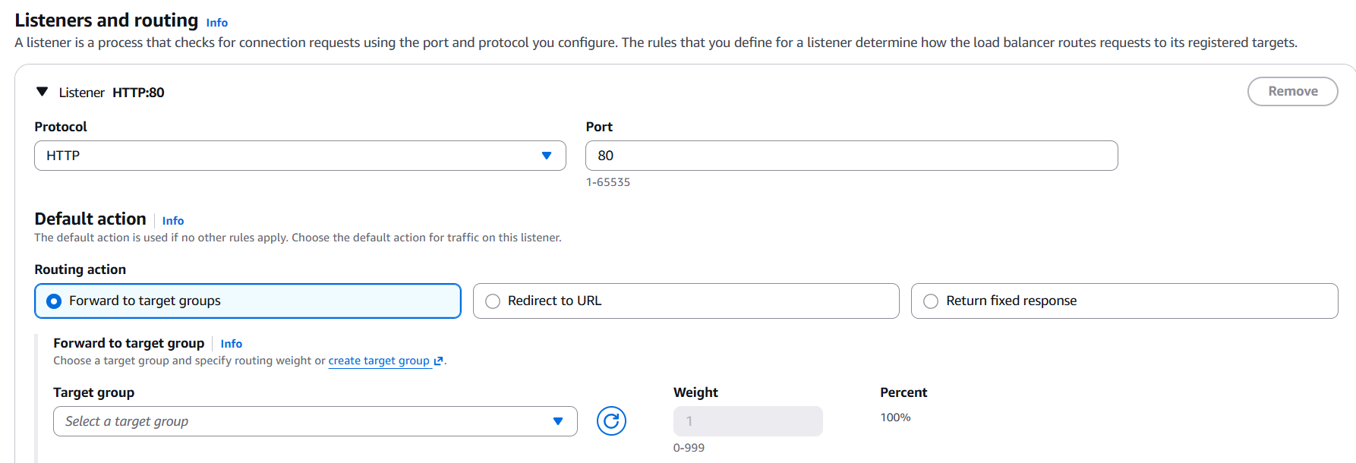
28. In Listeners and Routing, attach the Target Group created earlier.
ELB PROJECT DOCUMENTATION BY MOHIT GADILOHAR

Slide 29
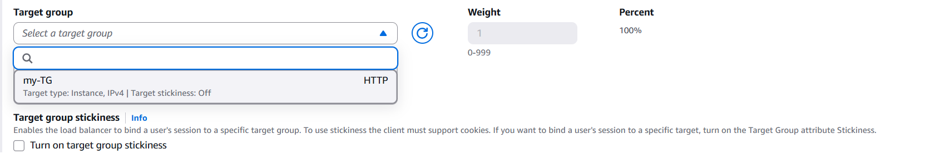
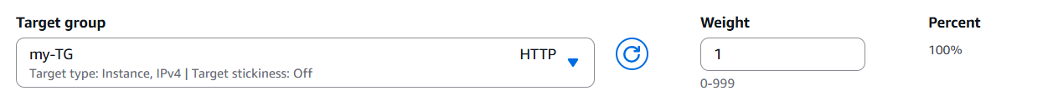
ELB PROJECT DOCUMENTATION BY MOHIT GADILOHAR

Slide 30
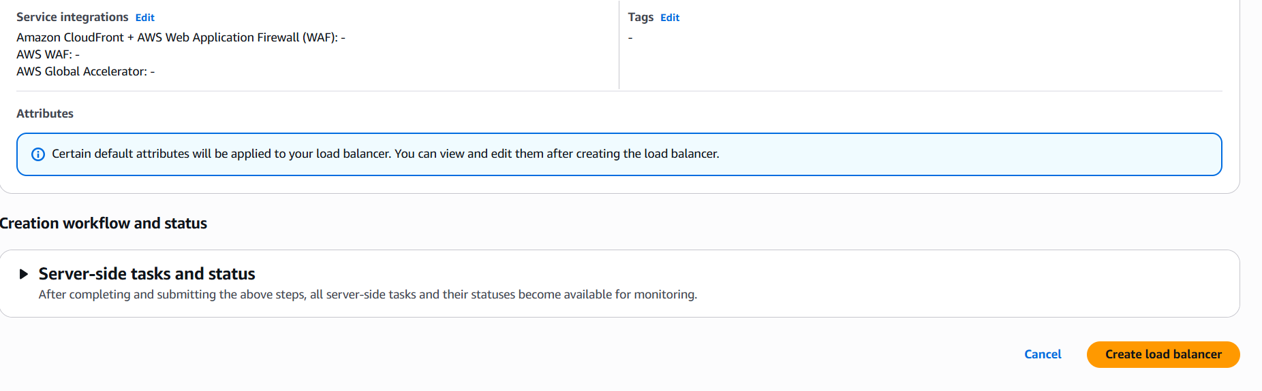
29. Scroll down and click Create Load Balancer.
ELB PROJECT DOCUMENTATION BY MOHIT GADILOHAR

Slide 31
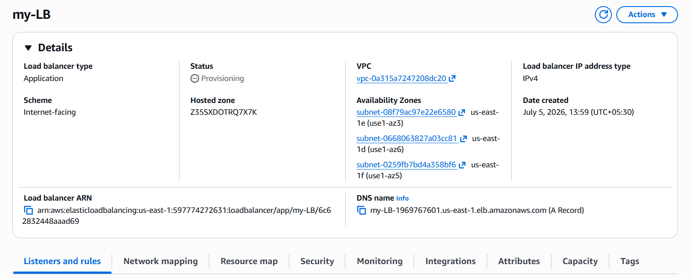
30. Wait for the ELB status to become Active
ELB PROJECT DOCUMENTATION BY MOHIT GADILOHAR

Slide 32
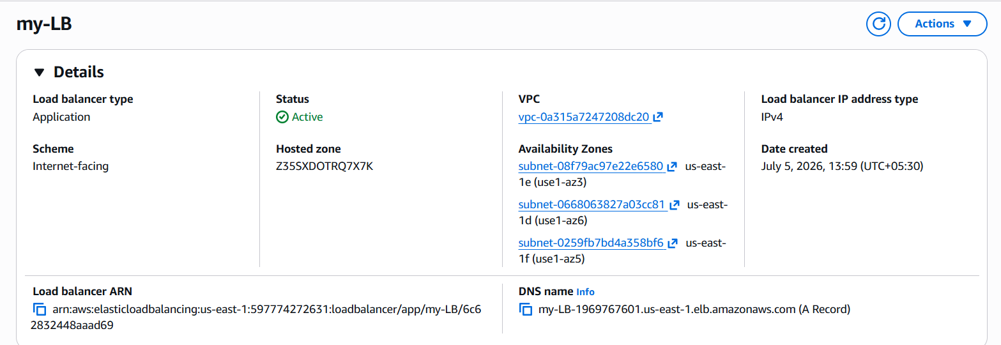
ELB PROJECT DOCUMENTATION BY MOHIT GADILOHAR

Slide 33

31. Copy the DNS mode And Go to the Incognito window and paste DNS mode.
ELB PROJECT DOCUMENTATION BY MOHIT GADILOHAR

Slide 34
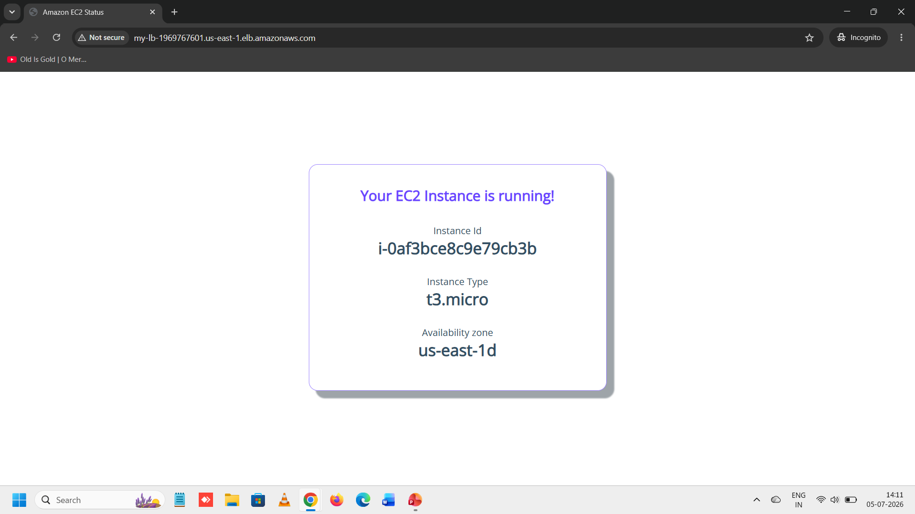
ELB PROJECT DOCUMENTATION BY MOHIT GADILOHAR

Slide 35
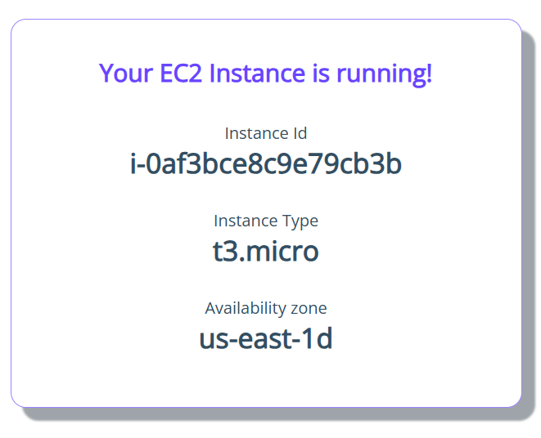
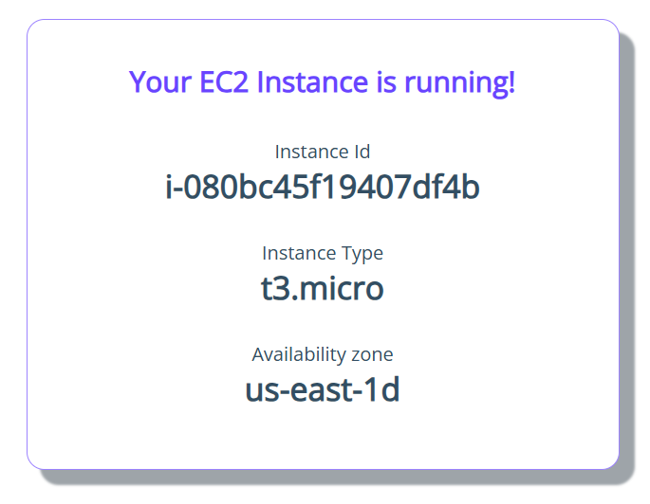
32. Click Refresh Button. And see the Instance rotate.
ELB PROJECT DOCUMENTATION BY MOHIT GADILOHAR

Slide 36
Architecture
Users
│
▼
Load Balancer
│
▼
Target Group
┌──────┼──────┐
▼ ▼ ▼
EC2-1 EC2-2 EC2-3
(Healthy)(Healthy)(Unhealthy)
▲ ▲
│ │
Traffic sent only to healthy instances
Security Group protects:
✔ Load Balancer
✔ EC2 Instances

Slide 37

ELB PROJECT DOCUMENTATION BY MOHIT GADILOHAR

